Slide 1
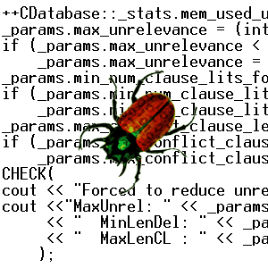

Model Checking and the
Verification of Computer Systems
Edmund M. Clarke
School of Computer Science
Carnegie Mellon University

Slide 2
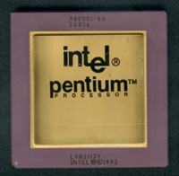
Intel Pentium FDIV Bug
Try 4195835 – 4195835 / 3145727 * 3145727 = ?
  In ’94 Pentium, it doesn’t return 0, but 256.
Intel uses the SRT algorithm for floating point division. Five entries in the lookup table are missing.
Cost: $400 - $500 million
Xudong Zhao’s Thesis on Word Level Model Checking

Slide 3
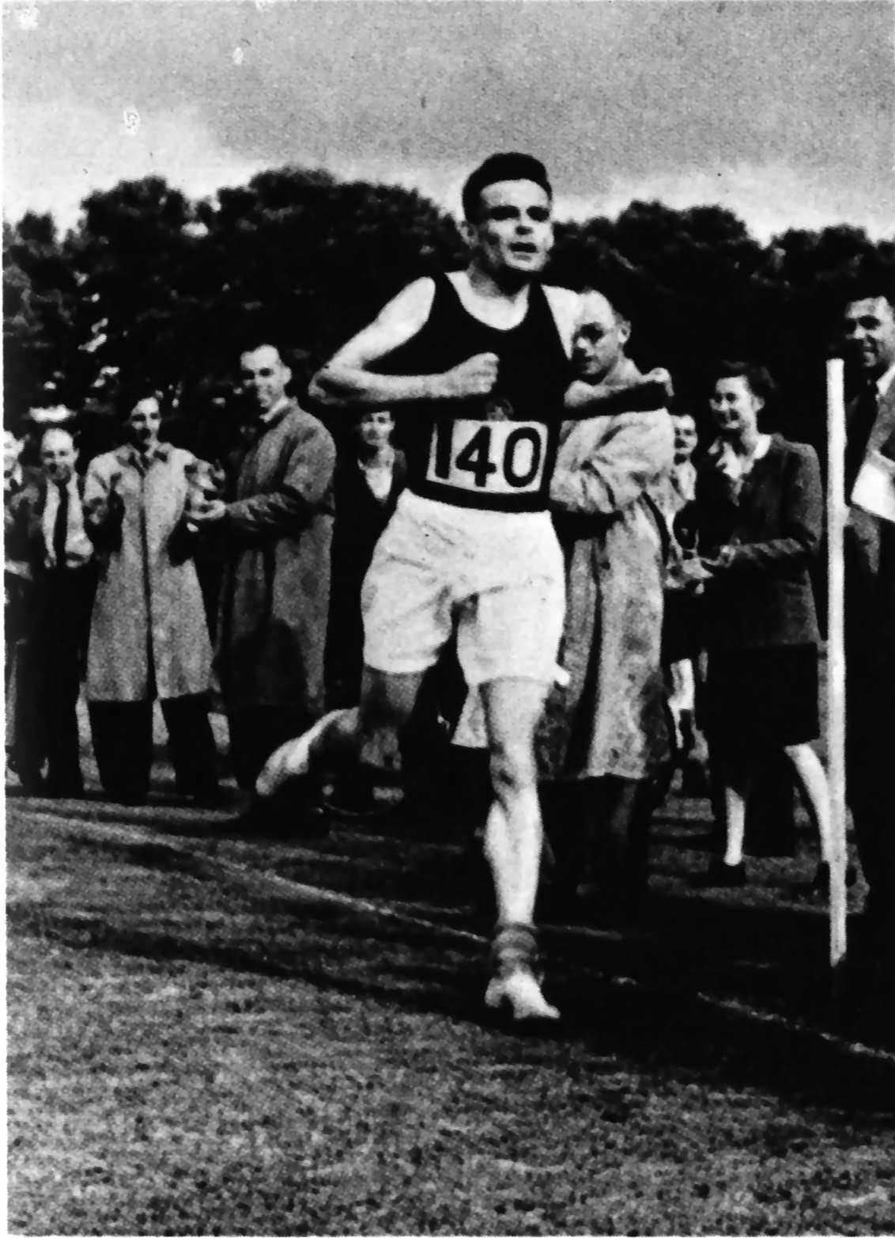
Turing's Quote on Program Verification
“How can one check a routine in the sense of making sure that it is right?”
“The programmer should make a number of definite assertions which can be checked individually, and from which the correctness of the whole program easily follows.”
Quote by A. M. Turing on 24 June 1949 at the inaugural conference of the EDSAC computer at the Mathematical Laboratory, Cambridge.

Slide 4
Temporal Logic Model Checking
Model checking is an automatic verification technique for finite state concurrent systems.
Developed independently by Clarke and Emerson and by Queille and Sifakis in early 1980’s.
The assertions written as formulas in propositional temporal logic. (Pnueli 77)
Verification procedure is algorithmic rather than deductive in nature.

Slide 5
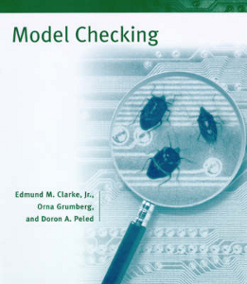
Advantages of Model Checking
No proofs!!! (Algorithmic rather than Deductive)
Fast (compared to other rigorous methods such as theorem proving)
Diagnostic counterexamples
No problem with partial specifications
Logics can easily express many concurrency properties
Second Edition on the way!

Slide 6
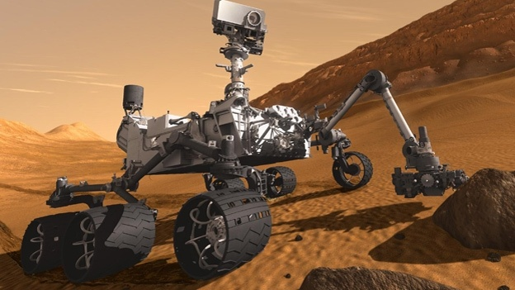
Model Checking NASA Missions
Gerard Holzmann (JPL)
The Spin Model Checker and Promela language.
Applied to most missions launched in the last decade.
Mars Curiosity

Slide 7
Model Checking in Industry
Many hardware companies use and develop model checkers: Intel, IBM, …
Microsoft makes intensive use of software model checking.
NEC: Varvel analyzed a total of about 40.5 M lines of code. Found more than a thousand bugs and bad coding patterns.

Slide 8
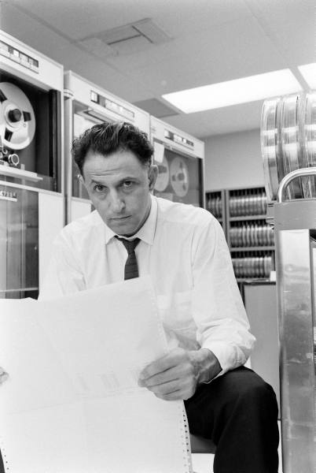
Main Disadvantage
Curse of Dimensionality:
“In view of all that we have said in the foregoing sections, the many obstacles we appear to have surmounted, what casts the pall over our victory celebration? It is the curse of dimensionality, a malediction that has plagued the scientist from the earliest days.”
Richard E. Bellman
Adaptive Control Processes: A Guided Tour
Princeton University Press, 1961

Slide 9
Main Disadvantage (Cont.)
1
a
2
||
b
n states,
m processes
3
c
1,a
n^{m} states
2,a
1,b
3,a
2,b
1,c
3,b
2,c
3,c

Slide 10
Main Disadvantage (Cont.)
Curse of Dimensionality:
The number of states in a system grows
exponentially with its dimensionality
(i.e. number of variables or bits or processes).
This makes the system harder to reason about.
Unavoidable in worst case, but steady progress over the
past 30 years using clever algorithms, data structures, and engineering

Slide 11
LTL - Linear Time Logic (Pn 77)
Determines Patterns on Infinite Traces
Atomic Propositions
Boolean Operations
Temporal operators
a “a is true now”
X a “a is true in the neXt state”
F a “a will be true in the Future”
G a “a will be Globally true in the future”
a U b “a will hold true Until b becomes true”
a

Slide 12
LTL - Linear Time Logic (Pn 77)
Determines Patterns on Infinite Traces
Atomic Propositions
Boolean Operations
Temporal operators
a “a is true now”
X a “a is true in the neXt state”
F a “a will be true in the Future”
G a “a will be Globally true in the future”
a U b “a will hold true Until b becomes true”
a

Slide 13
LTL - Linear Time Logic (Pn 77)
Determines Patterns on Infinite Traces
Atomic Propositions
Boolean Operations
Temporal operators
a “a is true now”
X a “a is true in the neXt state”
F a “a will be true in the Future”
G a “a will be Globally true in the future”
a U b “a will hold true Until b becomes true”
a

Slide 14
LTL - Linear Time Logic (Pn 77)
Determines Patterns on Infinite Traces
Atomic Propositions
Boolean Operations
Temporal operators
a “a is true now”
X a “a is true in the neXt state”
F a “a will be true in the Future”
G a “a will be Globally true in the future”
a U b “a will hold true Until b becomes true”
a
a
a
a
a

Slide 15
LTL - Linear Time Logic (Pn 77)
Determines Patterns on Infinite Traces
Atomic Propositions
Boolean Operations
Temporal operators
a “a is true now”
X a “a is true in the neXt state”
F a “a will be true in the Future”
G a “a will be Globally true in the future”
a U b “a will hold true Until b becomes true”
a
a
a
a
b

Slide 16
Model Checking Problem
Let M be a state-transition graph.
Let ƒ be an assertion or specification in temporal logic.
Find all states s of M such that M, s satisfies ƒ.
LTL Model Checking Complexity:
(Sistla, Clarke & Vardi, Wolper)
singly exponential in size of specification
linear in size of state-transition graph.

Slide 17
Trivial Example
Microwave Oven
State-transition graph
describes system evolving
over time.
~ Start
~ Close
~ Heat
~ Error
Start
~ Close
~ Heat
Error
~ Start
Close
~ Heat
~ Error
~ Start
Close
Heat
~ Error
Start
Close
~ Heat
Error
Start
Close
~ Heat
~ Error
Start
Close
Heat
~ Error

Slide 18

Temporal Logic and Model Checking
The oven doesn’t heat up until the door is closed.
“Not heat_up holds until door_closed”
(~ heat_up) U door_closed

Slide 19
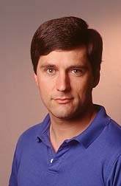
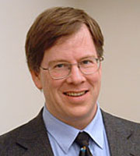
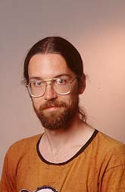
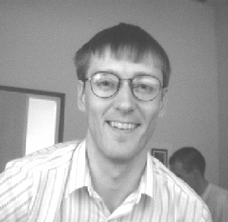
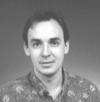
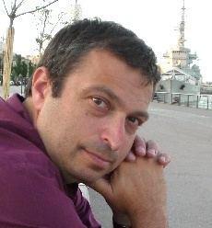
Four Big Breakthroughs in
Model Checking!
Symbolic Model Checking
Burch, Clarke, McMillan, Dill, and Hwang 90;
Ken McMillan’s thesis 92
.
The Partial Order Reduction
Valmari 90
Godefroid 90
Peled 94
Gerard Holzmann’s SPIN

Slide 20
Four Big Breakthroughs in
Model Checking!
Symbolic Model Checking
Burch, Clarke, McMillan, Dill, and Hwang 90;
Ken McMillan’s thesis 92
10²⁰ states.
The Partial Order Reduction
Valmari 90
Godefroid 90
Peled 94
Gerard Holzmann’s SPIN

Slide 21
Four Big Breakthroughs in
Model Checking!
Symbolic Model Checking
Burch, Clarke, McMillan, Dill, and Hwang 90;
Ken McMillan’s thesis 92
10¹⁰⁰ states . . .
The Partial Order Reduction
Valmari 90
Godefroid 90
Peled 94
Gerard Holzmann’s SPIN

Slide 22
Four Big Breakthroughs in
Model Checking!
Symbolic Model Checking
Burch, Clarke, McMillan, Dill, and Hwang 90;
Ken McMillan’s thesis 92
10¹²⁰ states . . .
The Partial Order Reduction
Valmari 90
Godefroid 90
Peled 94
Gerard Holzmann’s SPIN

Slide 23
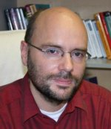
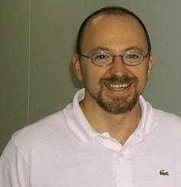
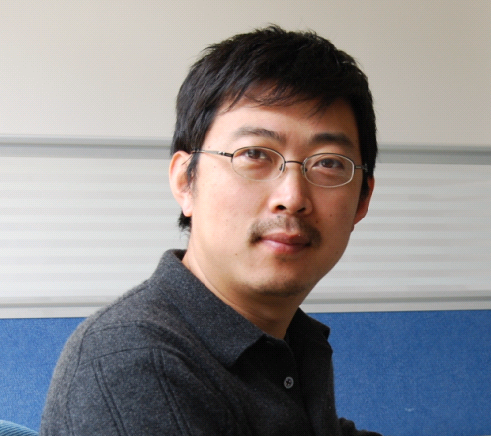
Four Big Breakthroughs in
Model Checking (Cont.)
Bounded Model Checking
  Biere, Cimatti, Clarke, Zhu 99
  Using Fast SAT solvers
  Can handle thousands
  of state elements
Can the given property fail in k-steps?
I(V₀) Λ T(V₀,V₁) Λ … Λ T(V_{k-1},V_{k}) Λ (¬ P(V₀) V … V ¬ P(V_{k}))
Property fails
in some step
Initial state
k-steps
BMC in practice: Circuit with 9510 latches, 9499 inputs
BMC formula has 4 x 10⁶ variables, 1.2 x 10⁷ clauses
Shortest bug of length 37 found in 69 seconds

Slide 24

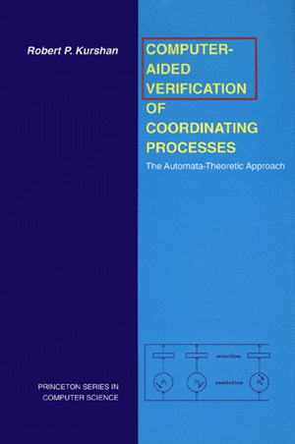
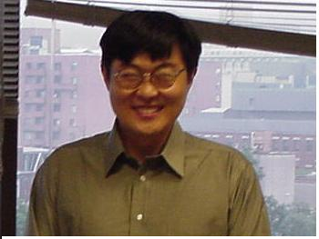
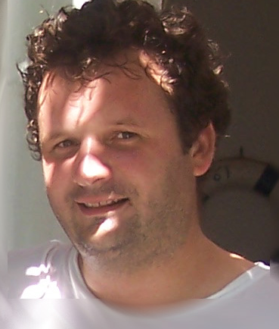

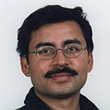
Four Big Breakthroughs in
Model Checking (Cont.)
Localization Reduction
  Bob Kurshan 1994
Counterexample Guided Abstraction Refinement (CEGAR)
  Clarke, Grumberg, Jha, Lu, Veith 2000
  Used in most software model checkers

Slide 25
CEGAR
Counter Example-Guided Abstraction Refinement
Initial
Abstraction
Verification
Circuit or
Program
Abstract
Model
No error
or bug found
Model
Checker
Property
holds
Counterexample
Refinement
Simulator
Simulation
sucessful
Abstraction refinement
Bug found
Spurious counterexample

Slide 26
Future Challenge
Is it possible to model check software?
According to Wired News on Nov 10, 2005:
“When Bill Gates announced that the technology was under development at the 2002 Windows Engineering Conference, he called it the Holy Grail of computer science”

Slide 27
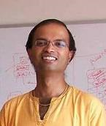

Software Example: Device Driver Code
Also according to Wired News:
“Microsoft has developed a tool called Static Device Verifier or SDV, that uses ‘Model Checking’ to analyze the source code for Windows drivers and see if the code that the programmer wrote matches a mathematical model of what a Windows device driver should do. If the driver doesn’t match the model, the SDV warns that the driver might contain a bug.”
Ball and Rajamani, Microsoft

Slide 28
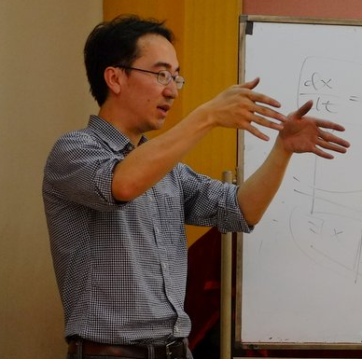
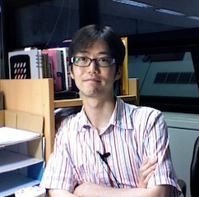
Model Checking Cyber-Physical Systems
Significant breakthrough in unifying logical reasoning and numerical methods [Gao et al. LICS’12, IJCAR’12, PhD Thesis, CADE’13, FMCAD’13]
Delta-Reachability: theory and tools for performing model checking & parameter synthesis on nonlinear cyber-physical systems.
Sicun Gao and Soonho Kong

Slide 29
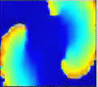
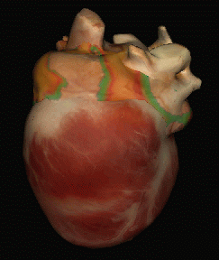
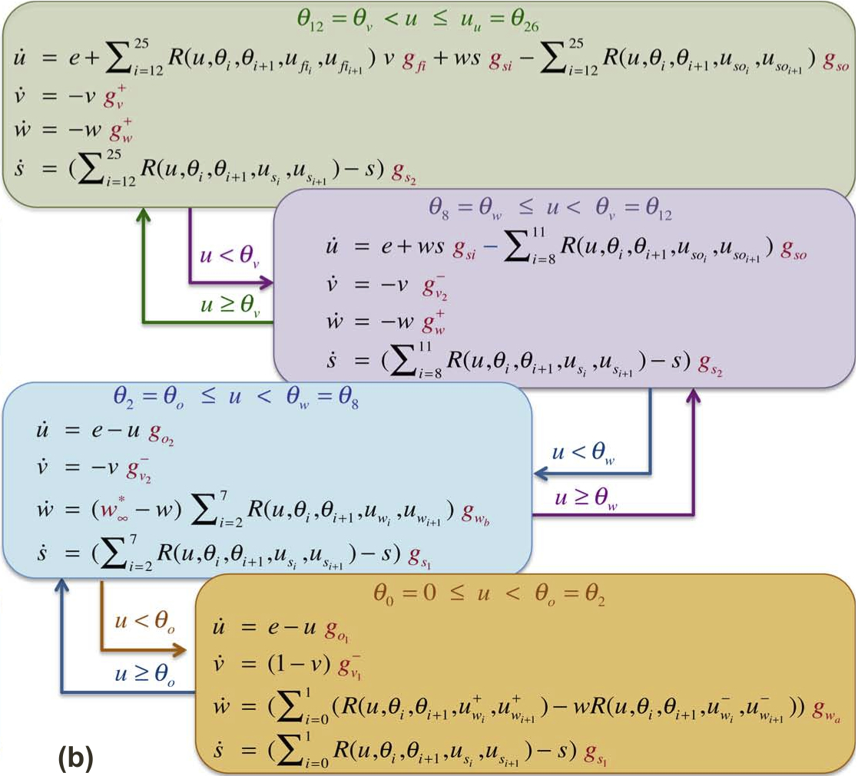
Example: Cardiac Cells Model
[Radu et al. CAV 2011]
Model Checking Results:
  Nonlinear ODEs with sigmoids:
  Solved logic formulas with hundreds of such ODEs. [Gao et al FMCAD 13]
  Counterexamples indicate when cardiac cells lose excitability. Confirmed by experimental data.

Slide 30
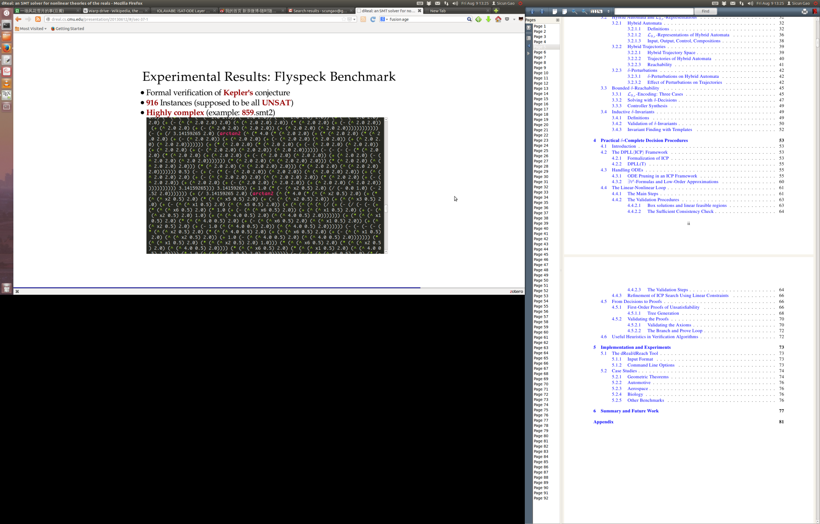
Example: The Kepler Conjecture
The Flyspeck project led by by Thomas Hales aims for a complete formal proof of the Kepler Conjecture. [Hales 2005]
The full proof has one last piece unfinished: proving correctness of a thousand nonlinear real constraints.
Very Difficult: Huge combinations of polynomials and trigonometric functions.
We solved over 95% of the Flyspeck benchmarks. Automated generation of proofs is in progress.
(showing 4% of a typical formula)

Slide 31
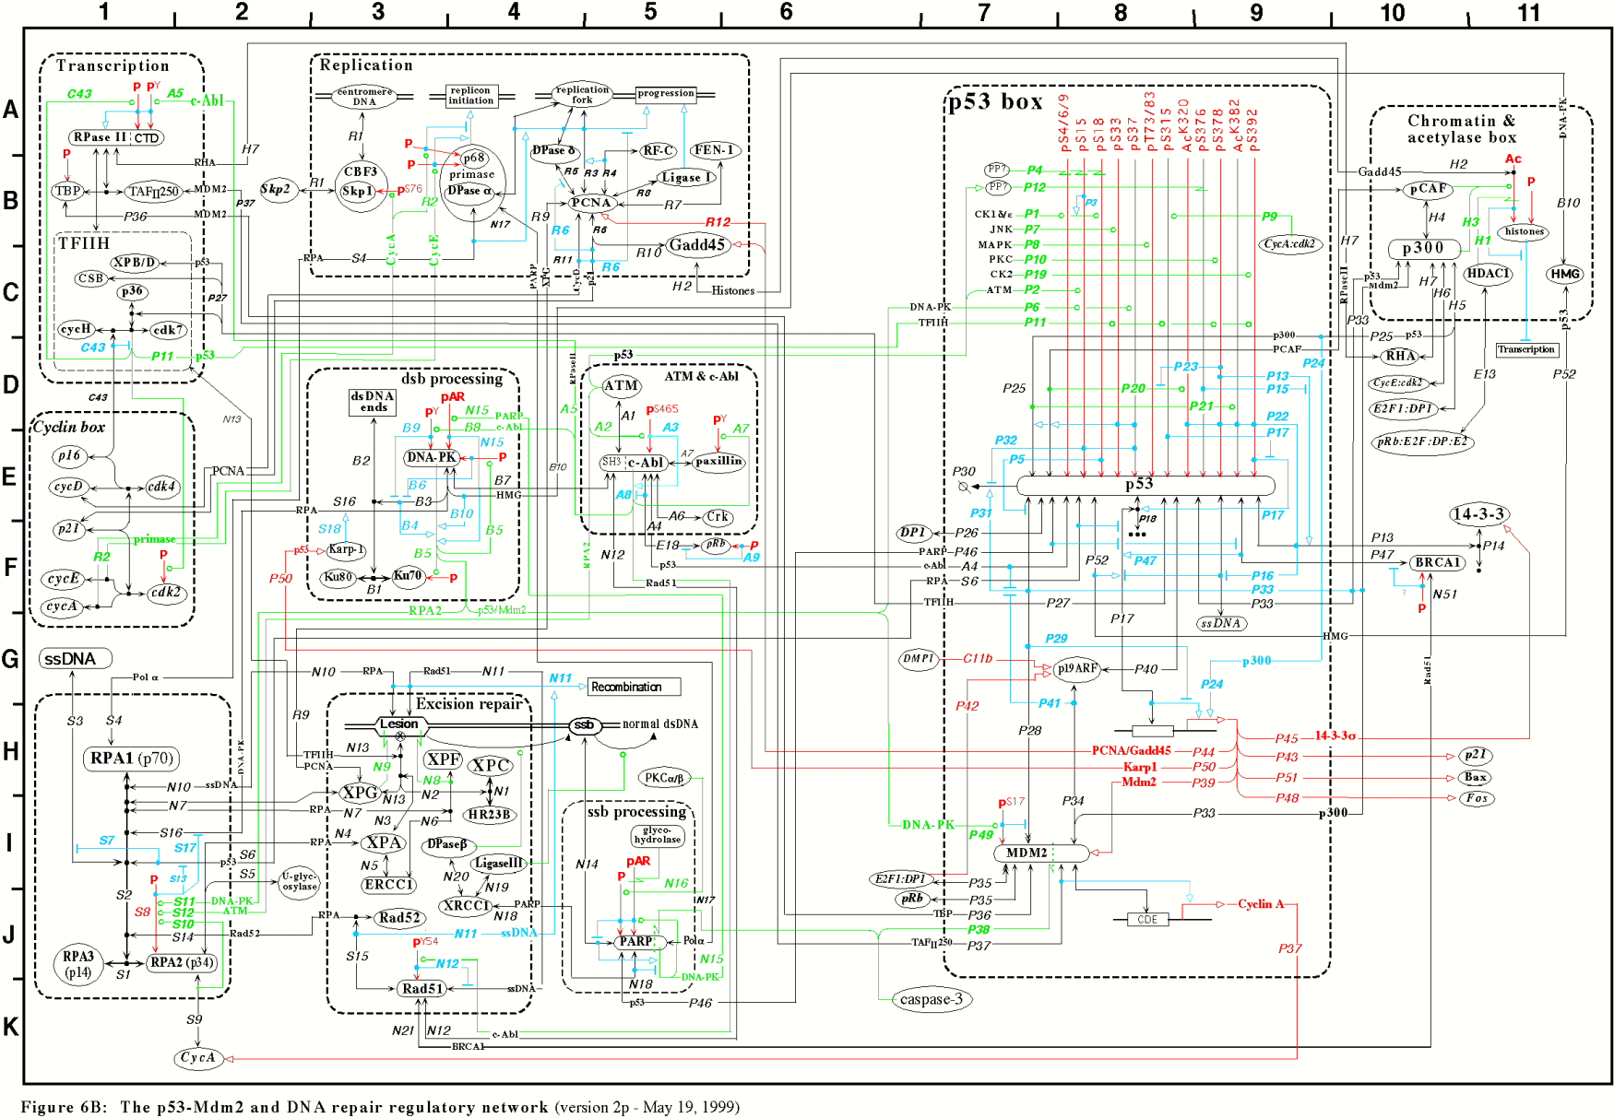
Future Challenge:
Can We Debug This Circuit?
Kurt W. Kohn, Molecular Biology of the Cell 1999

Slide 32
The End
Questions?
Papers and Programs:
OBDD Based Model Checker: nuSMV
Hybrid System Model Checker: dReal (http://dreal.cs.cmu.edu)
Computational Modeling and Analysis for Complex Systems: CMACS (http://cmacs.cs.cmu.edu)

